Slide 1
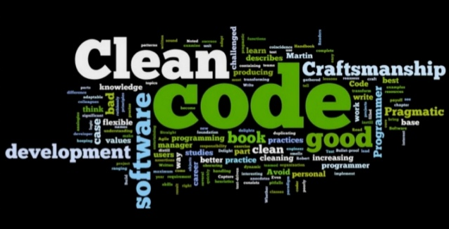
Writing Code for Humans
Paran
Odessa Technologies, Inc.

Slide 2
Clean Code
Agenda
Introduction
Naming
Classes
Functions
Conditionals
Comments
Demo
Summary

Slide 3
Introduction
Coding is for humans
Any fool can write code that a computer can understand.
Good programmers write code that humans can understand.
Martin Fowler

Slide 4
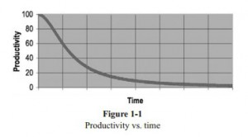
Introduction
Total Cost of Owning a Mess

Slide 5
Clean Code
Naming
Why naming is critical
Class names to avoid
Avoiding nasty unexpected function side-effects
Principles for selecting good variable names

Slide 6
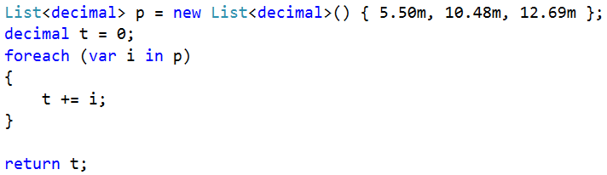
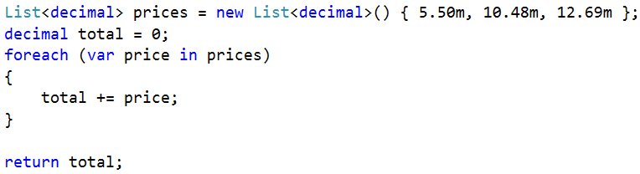
Naming
Naming Matters
Dirty
Clean

Slide 7

Naming
Naming Classes
WebsiteBO
Utility
Common
MyFunctions
JimmysObjects
*Manager / *Processor/*Info
User
Account
QueryBuilder
Products
Dirty
Clean
Guidelines
Noun
Be specific
Single Responsibility
Avoid generic suffixes

Slide 8
Naming
Naming Methods
Dirty
Clean
Get
Process
Pending
DoIt
Start
On_Init, Page_Load, etc.
GetActiveUsers
IsValidSubmission
ImportDocument
SendEmail

Slide 9
Naming
Naming Methods
And
If
Or

Slide 10
Naming
Watch for side effects
CheckPassword shouldn’t log users out.
ValidateSubmission shouldn’t save.
GetUser shouldn’t create their session.
ChargeCreditCard shouldn’t send emails.
Solution ?
Refactor until the method name completely describes what it does.

Slide 11

Naming
Avd Abbr
It’s not the 80’s
No standard
We talk about code
RegUsr
RegistUser
RegisUser
RegisterUsr

Slide 12
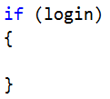
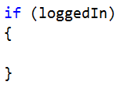
Naming
Boolean names
Dirty
Clean
open
start
status
login
isOpen
done
isActive
loggedIn

Slide 13
Naming
Summary
Strive for specific class names
The name should say it all
Watch for nasty function side-effects
Booleans should sound “truthy” and “falsy”

Slide 14
Clean Code
Classes
When to create a class
Cohesion
Primitive Obsession
Principle of Proximity
Outline Rule

Slide 15
Classes
When to create a class
New Concept
Abstract or Real world
Low Cohesion
Methods should relate
Promote Reuse
Small, targeted => reuse
Reduce Complexity
Solve once, hide away
Clarify Parameters
Identify a group of data

Slide 16
Classes
High Cohesion
Low
High
Vehicle
Edit vehicle options
Update pricing
Schedule maintenance
Send maintenance reminder
Select financing
Calculate monthly payment
Vehicle
Edit vehicle options
Update pricing
VehicleMaintenance
Schedule maintenance
Send maintenance reminder
VehicleFinance
Select financing
Calculate monthly payment

Slide 17
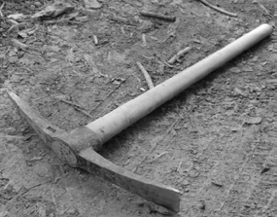
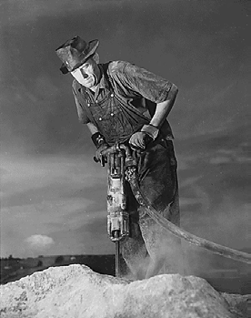
Classes
Primitive Obsession
Dirty
Clean
Helps reader conceptualize
Implicit -> Explicit
Encapsulation
Aids maintenance
Easy to find references

Slide 18
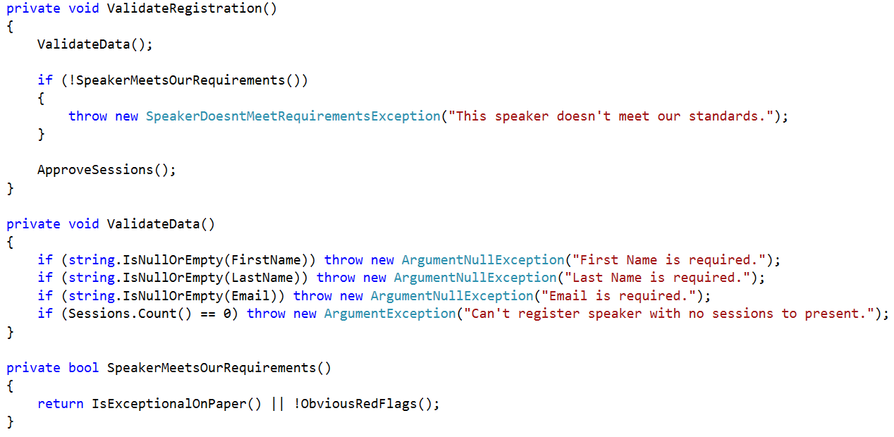
Classes
Principle of Proximity
Strive to make code read top to bottom when possible
Keep related actions together

Slide 19
Classes
Summary
Cohesion – Strongly related methods
Watch for Primitive Obsession
Organize to read top-bottom where possible
Place related code together

Slide 20
Clean Code
Functions
When to create a function
Techniques to maintain simplicity
Code smells and refactoring techniques
Error handling

Slide 21
Functions
When to create a function
Duplication
Indentation
Unclear intent
>1 task

Slide 22

Functions
Duplication
Don’t repeat yourself
Code is a liability
Less is more

Slide 23
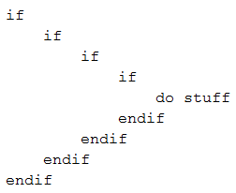
Functions
Excessive Indentation
Comprehension decreases beyond three levels of nested 'if' blocks.

Slide 24
Functions
Excessive Indentation: Soln
Extract Method
Fail Fast
Return Early

Slide 25
Functions
Extract Method
Before
if
if
end if
end if
After
if
if
doComplicatedThing()
end if
end if
while
do
some
complicated
thing
end while
doComplicatedThing()
{
while
do some
complicated thing
end while
}

Slide 26
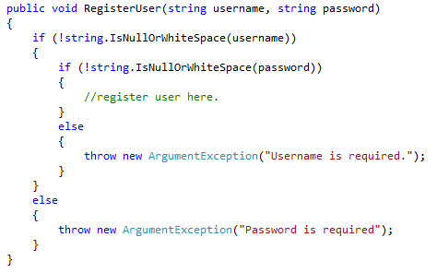
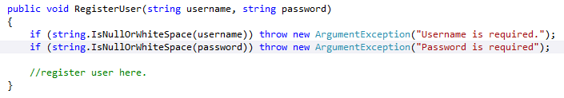
Functions
Fail Fast
Dirty
Clean

Slide 27
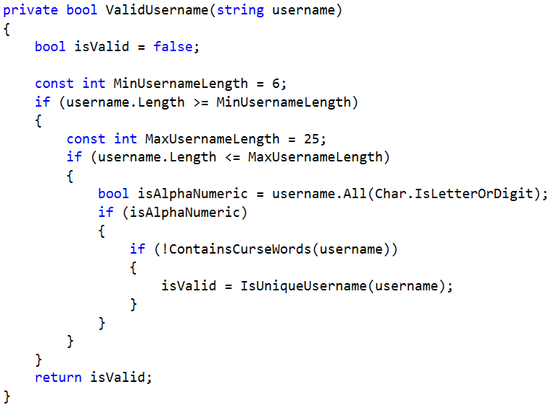
Functions
Return Early

Slide 28
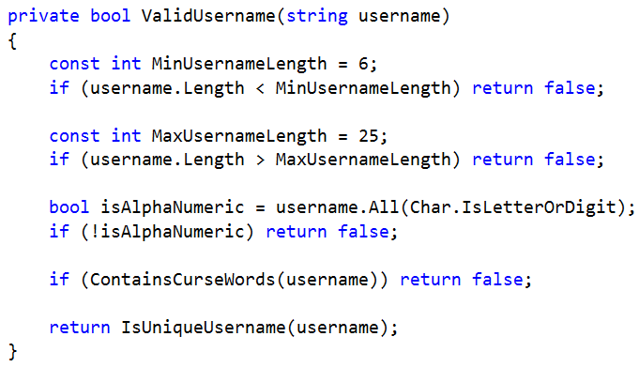
Functions
Return Early

Slide 29
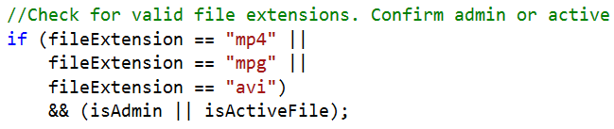
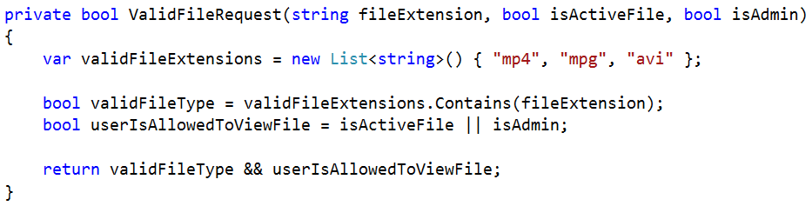
Functions
Convey Intent
Dirty
Clean

Slide 30
Functions
Do one thing
Aids the reader
Promotes reuse
Eases naming and testing
Avoids side-effects

Slide 31
Functions
How many parameters?
Strive for 0 - 2 parameters
Easier to understand
Easier to test
Helps assure function does one thing
Dirty
Clean

Slide 32
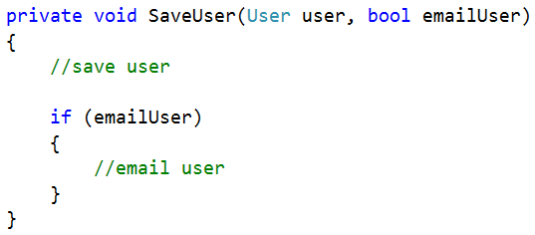
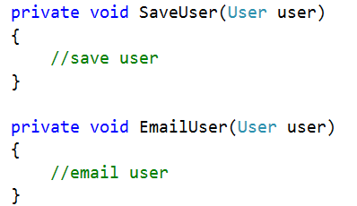
Functions
Watch for Flag Arguments
A sign the function is doing two things.
Dirty
Clean

Slide 33
Functions
Signs its too long
Whitespace & Comments
Scrolling required
Naming issues
Multiple Conditionals
Hard to digest
Rarely be over 20 lines
Hardly ever over 100 lines
- Robert C. Martin

Slide 34
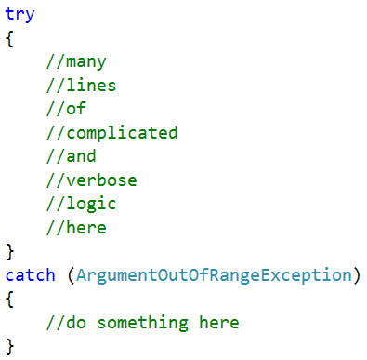
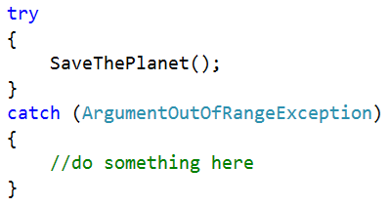
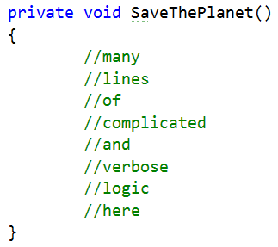
Functions
Try/Catch Body
Dirty
Clean

Slide 35
Functions
Summary
Duplication
Excessive Indentation and Solutions
Unclear Intent
Do One thing and one thing well

Slide 36
Clean Code
Conditionals
Clear Intent
Use the right tool
Complex Conditionals

Slide 37
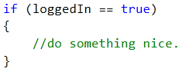
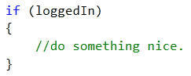
Conditionals
Compare Booleans Implicitly
Dirty
Clean

Slide 38
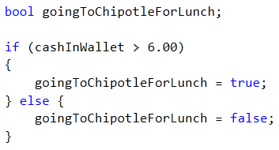
Conditionals
Assign Booleans Implicitly
Dirty
Fewer lines
No separate initialization
No repetition
Reads like speech
Clean

Slide 39
Conditionals
Don’t Be Anti-negative
Dirty
Clean

Slide 40
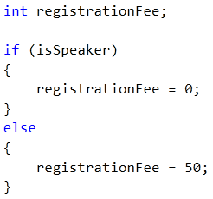
Conditionals
Ternary is elegant
Dirty
Clean

Slide 41
Conditionals
Avoid being “Stringly” Typed
Dirty
Strongly typed =>No typos
Intellisense support
Documents states
Searchable
Clean

Slide 42
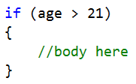
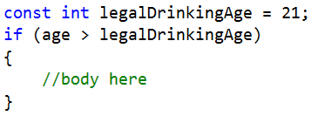
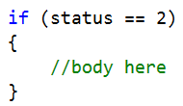
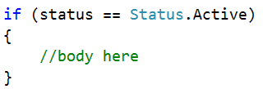
Conditionals
Magic Numbers
Dirty
Clean

Slide 43
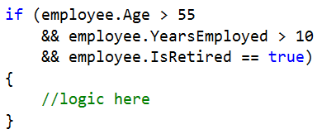
Conditionals
Complex Conditionals
Intermediate variables
Encapsulate via function

Slide 44
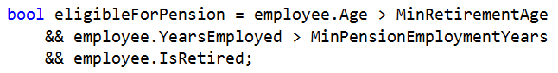
Conditionals
Intermediate Variables
Dirty
What question is this trying to answer?
Clean

Slide 45
Conditionals
Encapsulate Complex Conditions
Dirty
Principle: Favor expressive code over comments
Clean

Slide 46
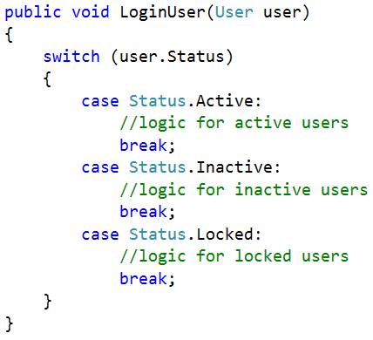
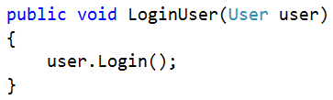
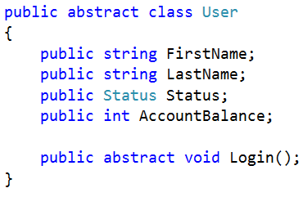
Conditionals
Polymorphism over Enums
Dirty
Clean

Slide 47
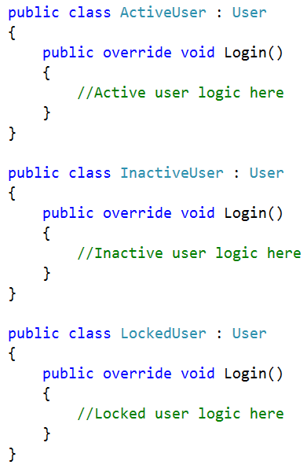
Conditionals
Polymorphism over Enums

Slide 48
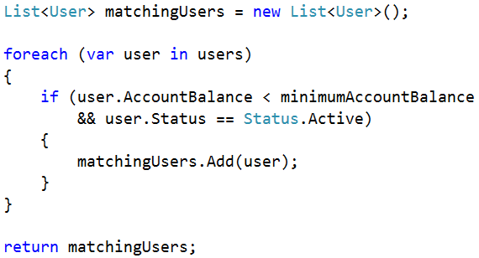
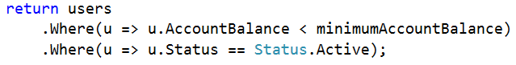
Conditionals
Be declarative if possible
Dirty
Clean

Slide 49
Conditionals
Summary
Strive for clear intent without leaning on comments
Be strongly typed via constants and enums
Be declarative rather than iterative when possible

Slide 50

Clean Code
Comments
How do you write code that’s readable and maintainable by others?
Uh…I use comments?

Slide 51

Clean Code
Comments
I can’t understand your lousy code without comments. And…you smell like foot.
Comments lie. They’re not kept up to date. They’re either redundant or a crutch for bad code.
Hannah
Lilly
Are comments great, or a code smell?
Yes

Slide 52
Comments
Bad Comments
Redundant
Intent
Apology
Zombie Code
Divider
Defect Log

Slide 53
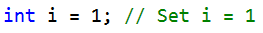
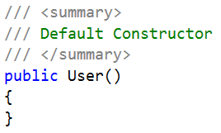
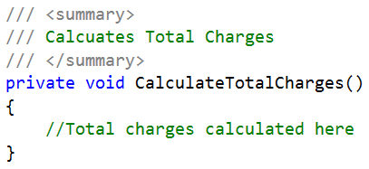
Comments
Redundant Comments
Dirty
Assume your reader can read
Don’t repeat yourself

Slide 54
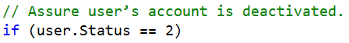
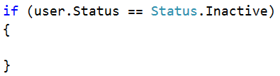
Comments
Intent Comments
Dirty
Clean
Instead, clarify intent in code:
Improved function naming
Intermediate variable
Constant or enum
Extract conditional to function

Slide 55
Comments
Apology Comments
Dirty
Don’t apologize.
Fix it before commit/merge.
Add a TODO marker comment if you must

Slide 56
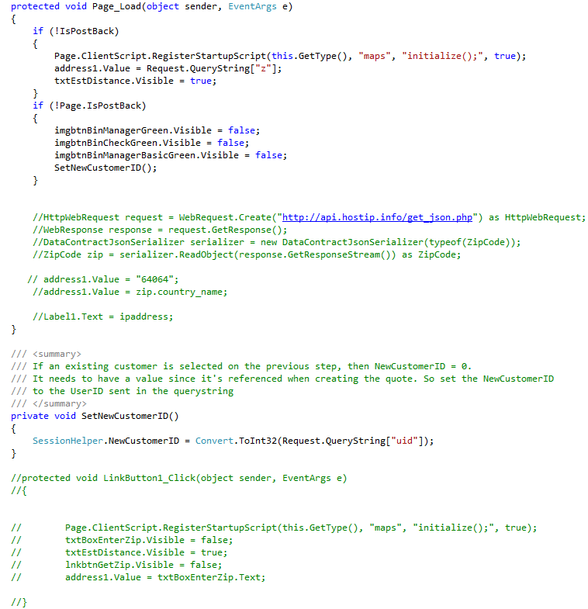
Comments
Zombie Code
Dirty

Slide 57
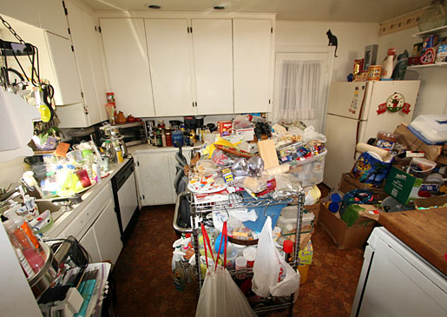
Comments
Common Causes
Risk Aversion
Hoarding mentality

Slide 58
Comments
Ambiguity Hinders Debugging
What did this section do?
Was this accidentally commented out?
Who did this?

Slide 59
Comments
Hinders Refactoring
Do I need to refactor this too?
How does my change impact this code?
What if someone uncomments it later?

Slide 60
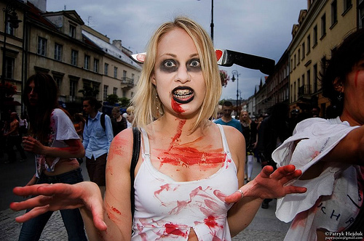
Comments
Kill Zombie Code
Reduces readability
Creates ambiguity
Hinders refactoring
Add noise to searches
Code isn’t “lost” anyway

Slide 61
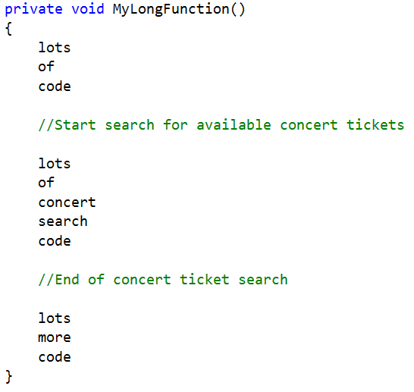
Comments
Divider Comments
Dirty
Need comments to divide function sections? please Refactor.

Slide 62
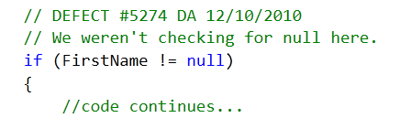
Comments
Defect Log
Dirty
Change metadata belongs in source control

Slide 63
Comments
Good Comments
To Do
Documentation

Slide 64
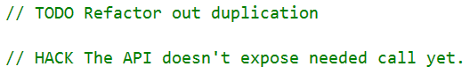
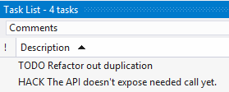
Comments
To Do Comments
Watch out:
May be an apology or warning comment in disguise
Often ignored

Slide 65
Comments
Documentation
Only when it can’t be expressed in code
Clean

Slide 66
Comments
About to write a comment?
For clean coders, comments are useful, but generally a last resort.

Slide 67
Comments
Summary
Goal: Convey intent
Strive for programming style as documentation
Use comments as last resort
Kill Zombie Code

Slide 68
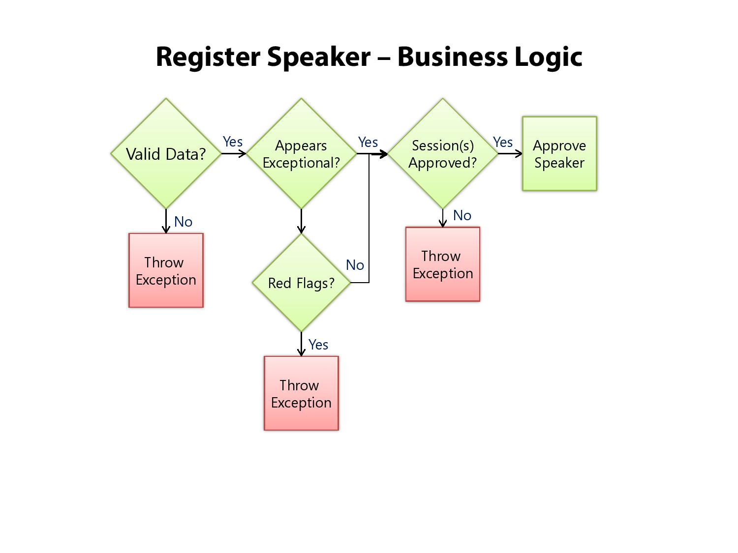
Demo
Register Speaker – Logic

Slide 69

Stay Clean

Slide 70

Stay Clean
Code Reviews
Promote proactive cleanliness
Follow guidelines / standards
Assure readability

Slide 71
Stay Clean
The Boy Scout Rule
"Always leave the campground cleaner than you found it“
"Always check a module in cleaner than when you checked it out"
- Robert C. Martin

Slide 72

Stay Clean
Common decency
Isn’t it like putting your trash in the bin instead of dropping it on the floor ?

Slide 73
Stay Clean
Summary
Refactor when necessary
Follow Coding guidelines & standards
Do self code review
Pair and share your knowledge
Leave the code a little better than you found it!

Slide 74
Questions ?
We are not Developers any more, we are a Clean Code Developers !!!
Clean Code makes everyone HAPPY !!!

